Slide 1
HACKATHON CHALLENGES
23rd – 25th November 2018

Slide 2
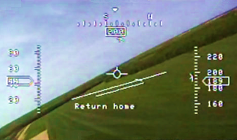
Challenge 1 Virtual Flight Deck
AI
Web
Cybersec
Algorithms
Game Engine
Scenario:
Produce a virtual flight deck for an autonomous platform flying through a simulated environment
Objectives:
Parse external track data
Develop a virtual world model
Create controllable platforms
Render external tracks in FOV

Slide 3
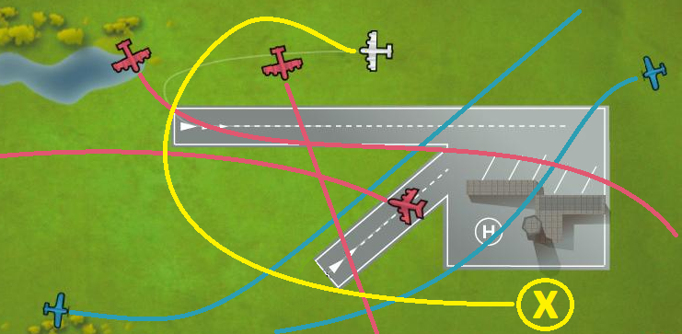
Challenge 2 Autonomous Detect and Avoid
AI
Web
Cybersec
Algorithms
Game Engine
Scenario:
Manned platforms flying in congested airspace
Create a virtual platform/s with behaviour for
avoiding the manned platforms
Objectives:
Parse the ADS-B “manned platform” data
Create a virtual unmanned platform
Write an algorithm for avoiding manned entities
Develop a means of visualising flight paths, separation distance, alerts, etc

Slide 4
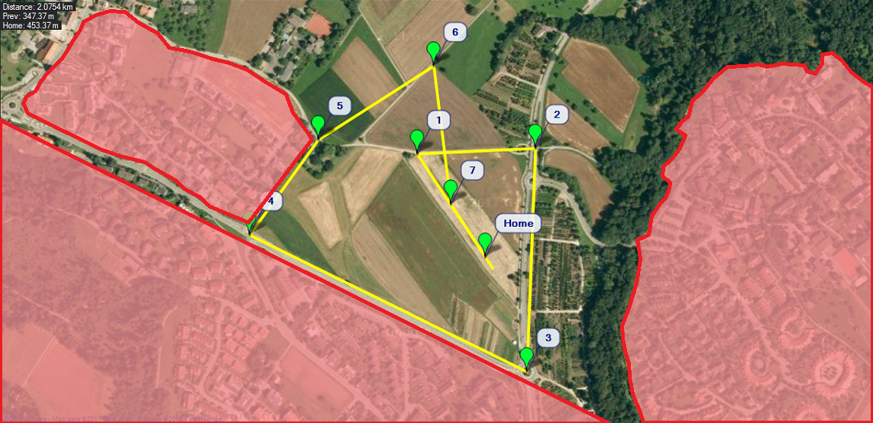
Challenge 3 UAV Mission Control
AI
Web
Cybersec
Algorithms
Game Engine
Scenario:
Automate and optimise UAV missions for inspecting Point of Interest (POIs)
Objectives:
Parse POI data
Create an algorithm for optimising POI
inspection
Develop a means of visualising missions
Add in “no-fly-zone” avoidance
Include re-fueling/re-charging considerations into algorithm

Slide 5
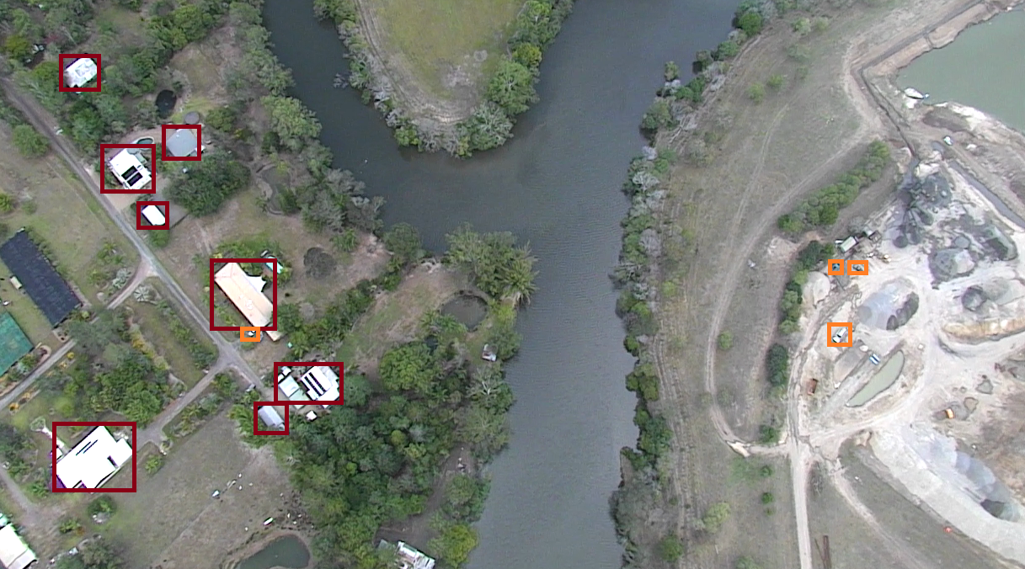
Challenge 4 Airborne Imagery Analysis
AI
Web
Cybersec
Algorithms
Game Engine
Scenario:
Use image classification techniques to identify ground artefacts in airborne video data
Objectives:
Develop a classification models for:
Recognising ground cover types
Identifying objects
Train and refine model with test data

Slide 6

Challenge 5 Intercepting Encrypted Data Links
AI
Web
Cybersec
Algorithms
Game Engine
Scenario:
An adversary operations centre is sending encrypted messages to airborne platforms
Messages are decrypted and display via a Data Link Console
A working DLC has been acquired by allied intelligence
Objectives:
Penetrate the protected RF network (WiFi)
Reverse engineering the message protocol and encryption algorithm
Intercept and spoof messages into an encrypted wireless network
Deny operations network from sending messages

